Slide 1
PZ-2025-2289
Project Comal Employment Center Plan
1051 County Road 401

Slide 2
Development Process
Comprehensive Plan Amendment – Changes to the Growth Sector, Future Land Use, or Transportation Master Plan. Can also be actions to amend the Comp. Plan to fulfill an Implementation Strategy.
Plan and/or Place Type Designation – Projects 2.5 acres and greater will go through an Employment Center, Neighborhood, or Infill Neighborhood Plan to layout new Centers or Neighborhoods and allocate Place Type Zoning Districts.
Preliminary Plat – Division of land into lots (identifying lot boundaries, streets, easements, etc.).
Subdivision Improvement Plans – Public Infrastructure Plans (Water, Sewer, Drainage).
Final Plat To be recorded after approved and accepted infrastructure improvements.
Site Development Plans – Engineered or surveyed drawings depicting proposed development on a lot(s).
Building Permit - Layout of building(s) on lot(s) and detailed construction drawings.

Slide 3
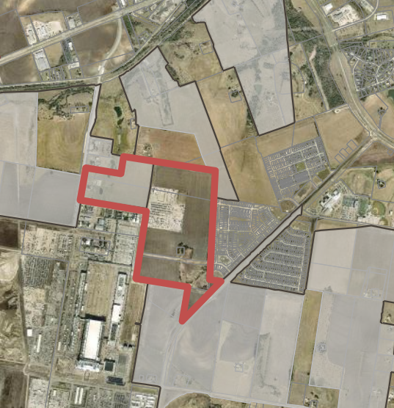
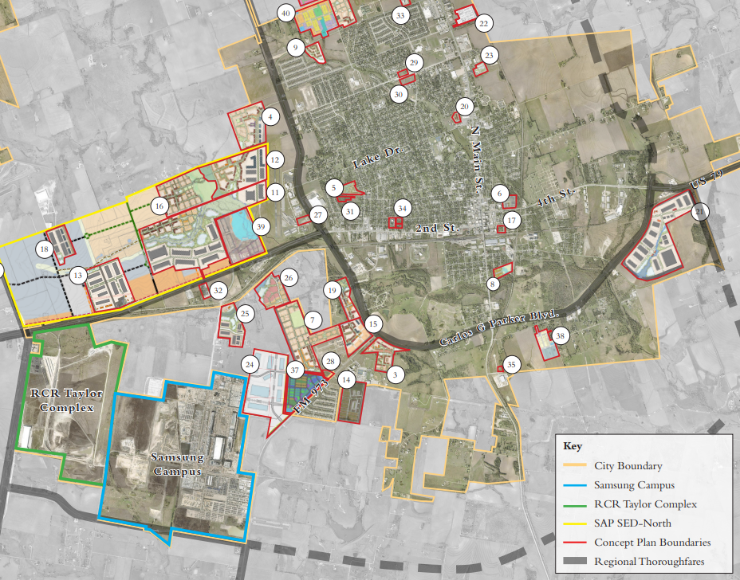
Location Map

Slide 4
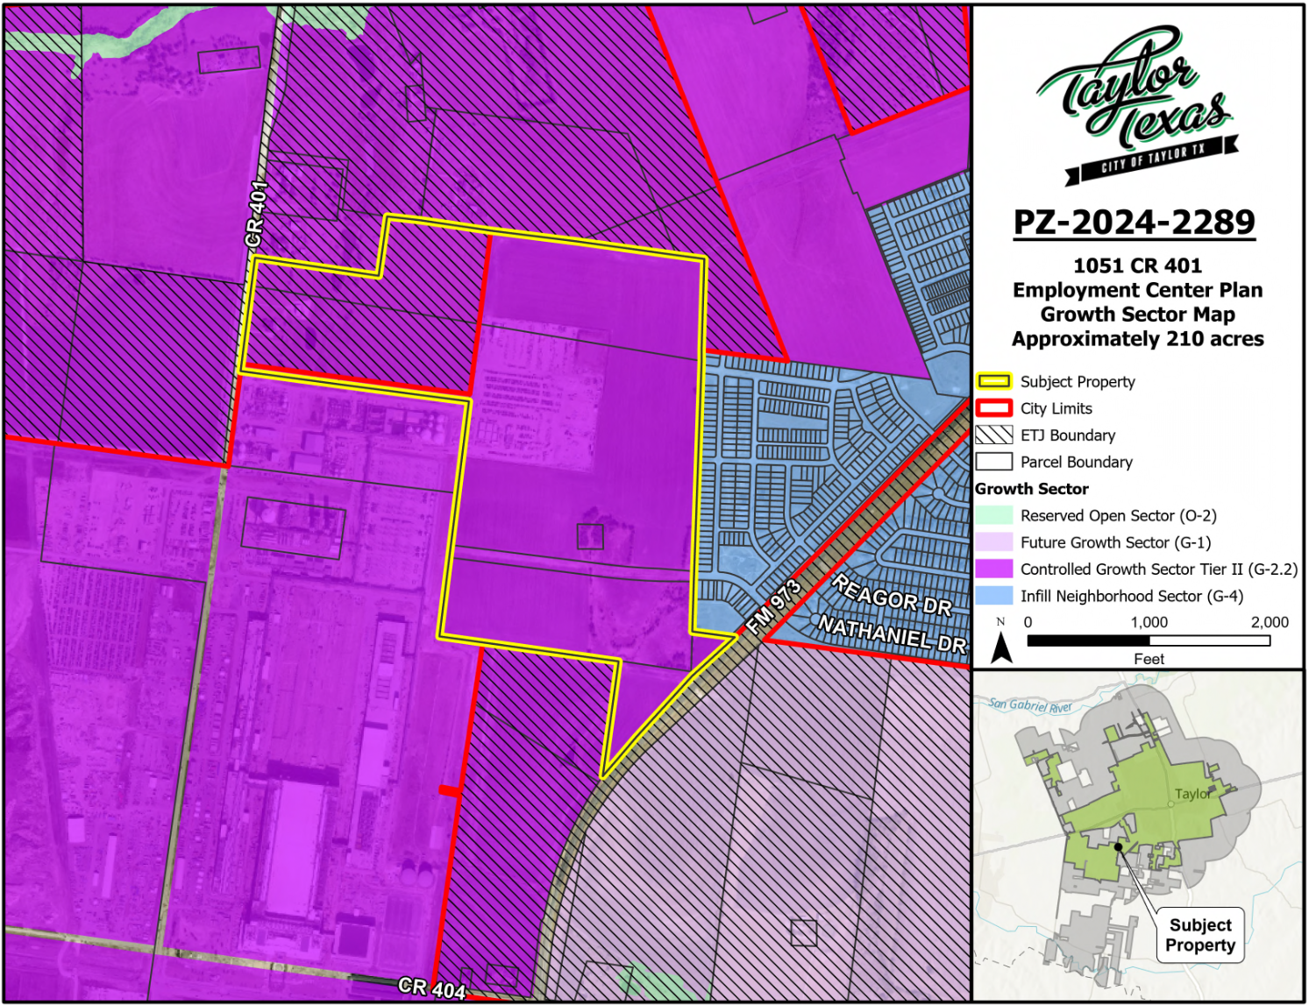
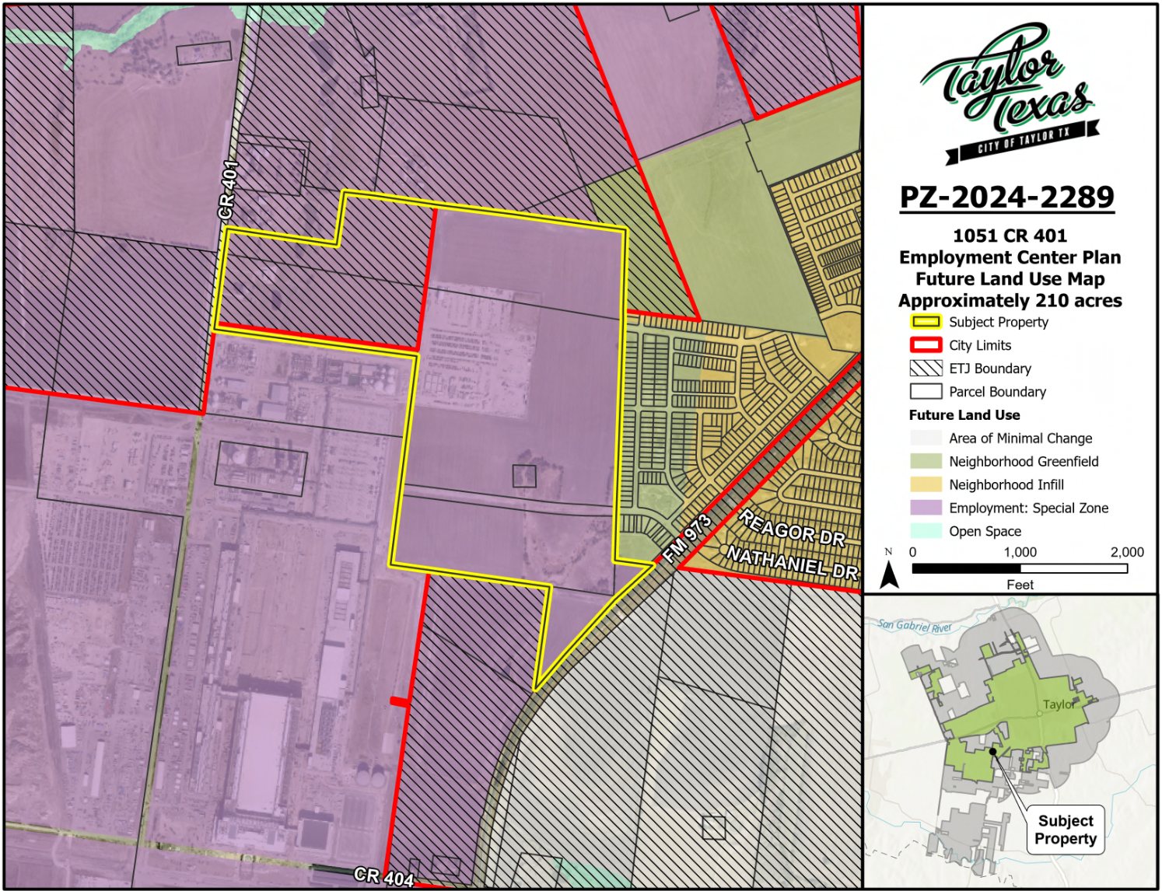
Growth Sector & Future Land Use Maps

Slide 5
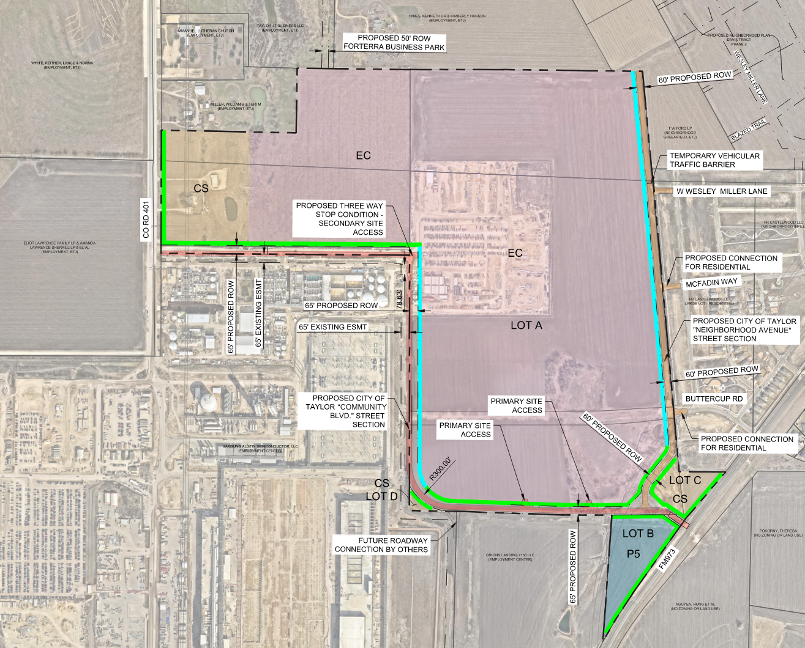
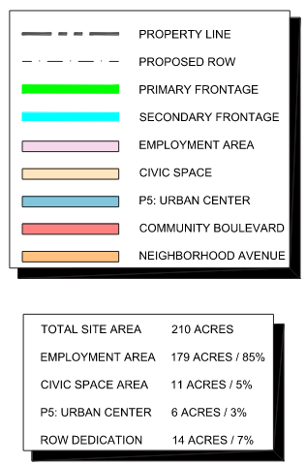
Regulating Plan

Slide 6
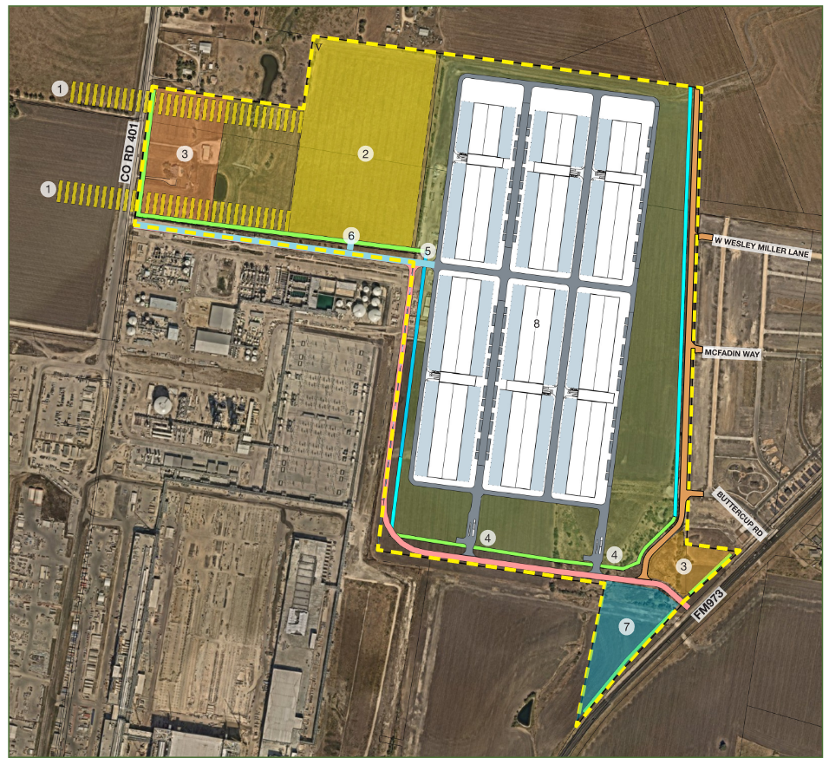
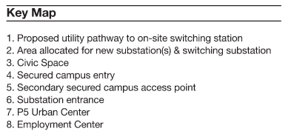
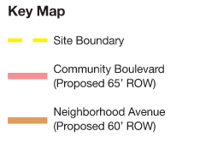
Thoroughfare Plan

Slide 7
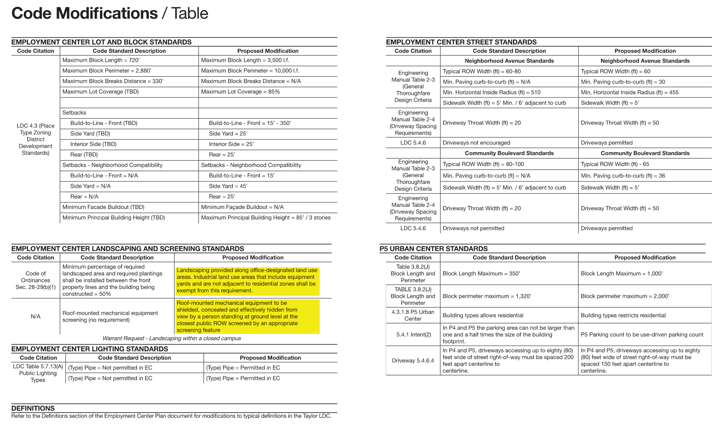
Proposed Warrants/Variances

Slide 8
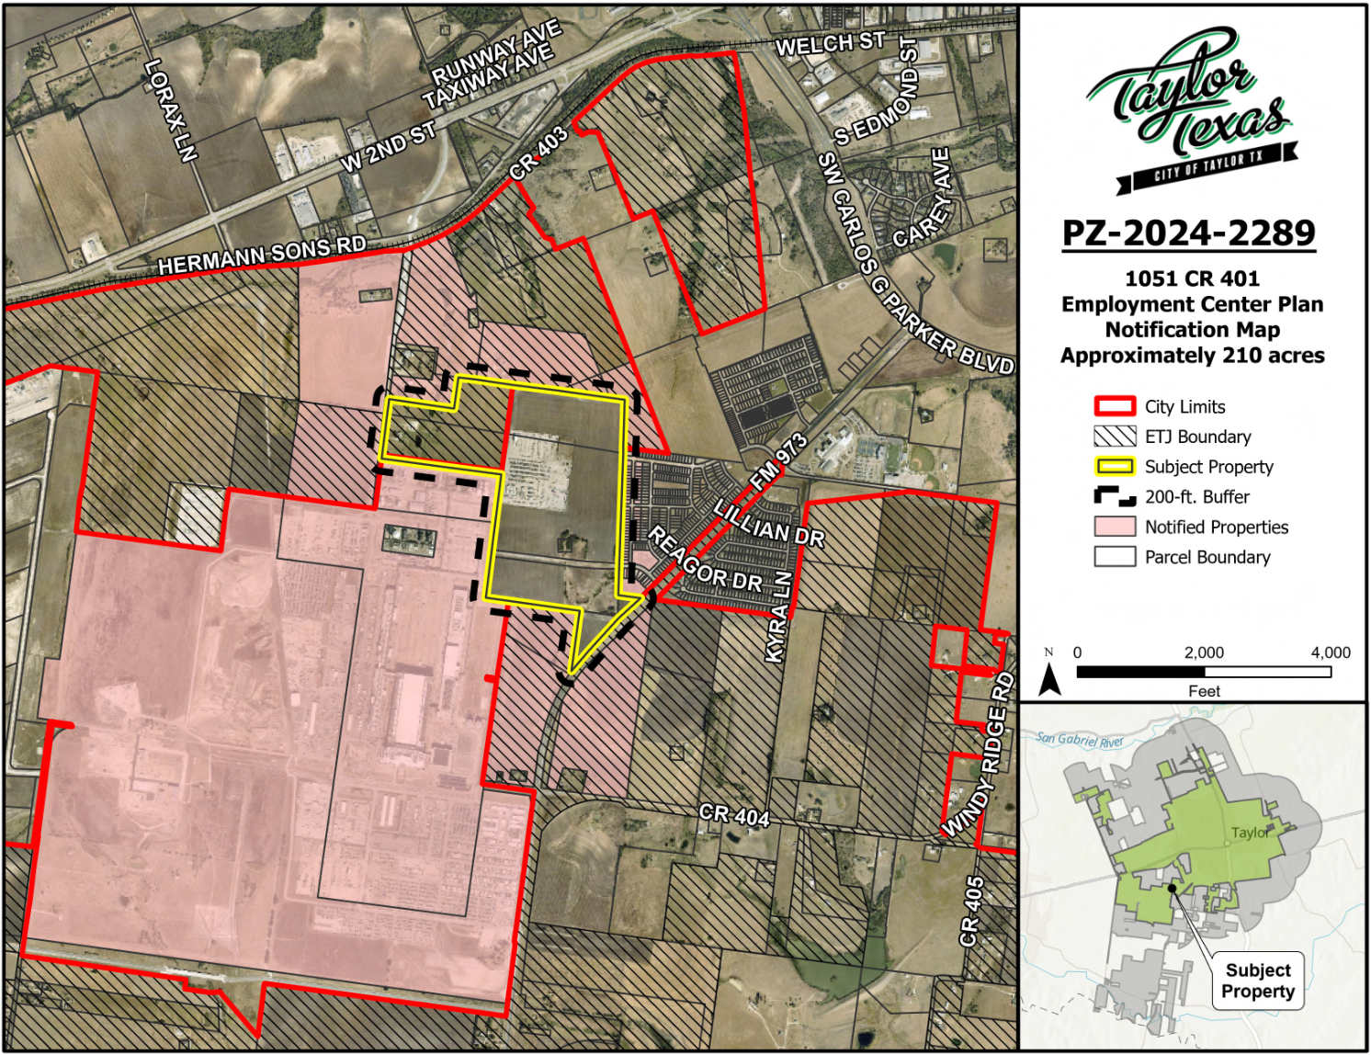
Notification Map
15 notices were sent out to adjacent property owners within 200 ft. of the subject property.
At the P&Z Public Hearing (11/12/25) 12 citizens spoke regarding their concerns with the proposed ECP and potential for Data Center usage.

Slide 9
Staff Analysis
The Employment Center Plan seeks to largely align with the surrounding industrial and commercial uses within the P5 Place Type allows for a transition into the neighborhood and allow for supporting uses.
Is the Employment Center Plan consistent with the Comprehensive Plan.
The Plan is consistent with the Comprehensive Plan. The proposed plan would increase the amount of commercial and industrial around the Samsung site.
Is the plan compatible with the surrounding area?
The plan is compatible with the surrounding properties to the North, South and West. A sufficient buffer is being provided for the proposed industrial and single-family.
Does the plan promote public health, safety, or general welfare?
Staff analysis determined that the proposed plan for the subject property will promote public health, safety, and the general welfare. In addition, the planning principles and policy guide in the comprehensive plan aim to promote health, safety, and general welfare by managing growth, while promoting safe and orderly development.
Is adequate infrastructure available or planned to meet the needs of the proposed land use?
The property will be able to tie into the existing infrastructure to serve this property.
Do current conditions indicate that an Employment Center Plan is necessary?
The property is currently zoned P2: Rural and to be consistent with the future land use, the Employment Center plan is necessary.

Slide 10
Planning & Zoning Commission Recommendation
On November 12, 2025, the P&Z held a public hearing and heard from 12 citizens regarding their concerns with the request. After the public hearing, the Commission voted to recommend disapproval. However, the motion failed (2-3).

